Slide 1
U.S. – Canada Border Data Warehouse
Schema and web portal for national data
by Melissa Fanucci
Senior Planner,
Whatcom Council of Governments
For the Transportation Border Working Group (TBWG)
Whatcom Council of Governments, Bellingham, WA ● 360-676-6974 ● melissa@wcog.org

Slide 2
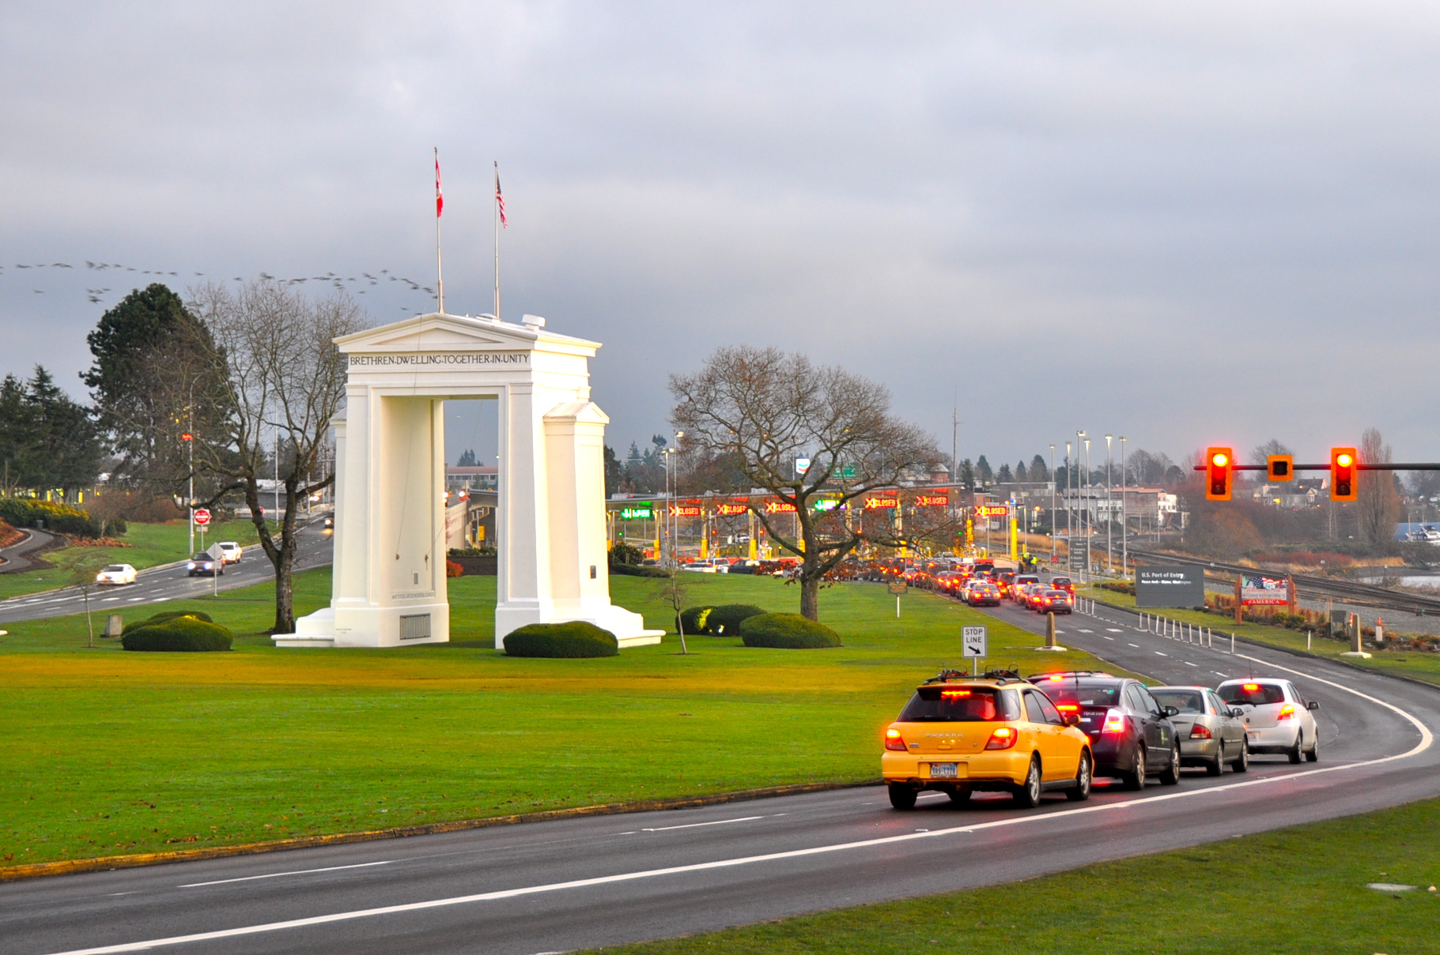
What is the Cascade Gateway Border Data Warehouse?
Traffic volume.
Wait times.
Service rate.

Slide 3
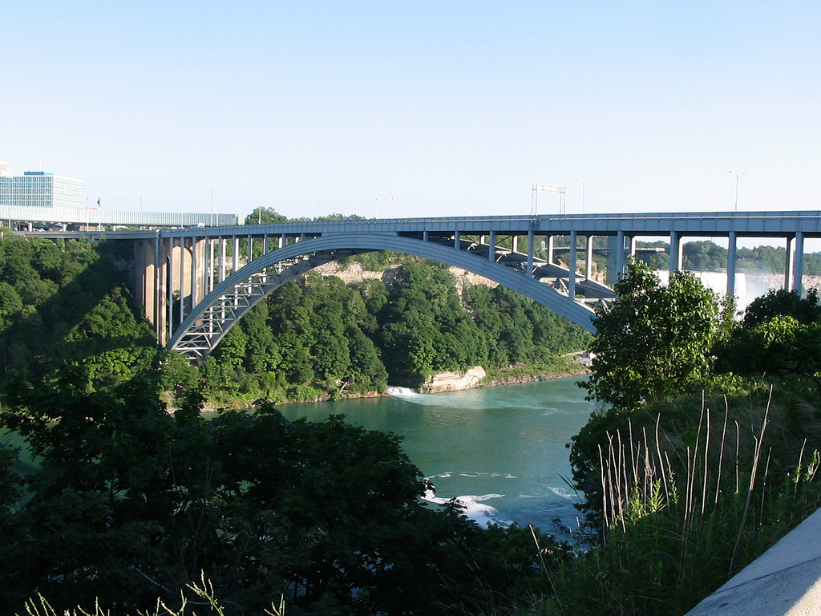
Expanded Border Data Warehouse
Three crossings.
Bluetooth wait times.
Seven agencies.

Slide 4
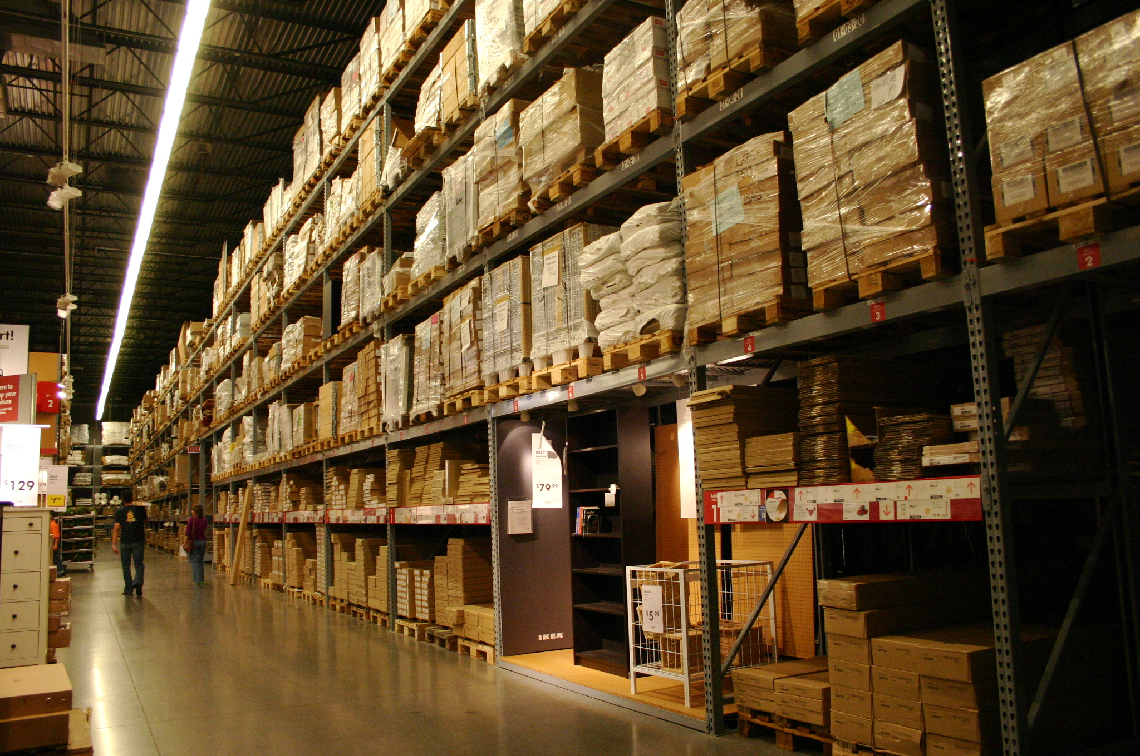
New system:
Inventory new data types:
Actual
Current
Predictive
Data in different format:
Links and Routes
No volume

Slide 5
U.S. border-wide archive
of common denominators
Cascade Gateway Portal
CascadeGatewayData.com
U.S.A. / Canada Portal
BorderDataWarehouse.com
Niagara Region
Portal
URL TBD
Wait times
Volume
Trucks, cars, NEXUS
Departure rate
WIM data
BTS data
Booth status data?
Wait times
Volume?
Booth status data?
Border Data Warehouse
(cloud server)

Slide 6
Architecture
MTO
WCOG
WCOG
WCOG
US-bound ATIS system
Cascade Gateway Portal
U.S. – Canada Portal
Niagara Region Portal
CBSA
MTO
Peace Bridge booth status data
Loop detectors
WCOG
Border Data Warehouse
NYDOT
U.S. CBP
Corridor travel times (toll tags)
Peace Bridge booth status data
NIAGARA FALLS BRIDGE COMMISSION
BUFFALO BRIDGE COMMISSION
U.S. CBP
CBSA
NIAGARA FALLS BRIDGE COMMISSION
Bridge loop detector data
Border delay websites/signs
Border delay website
Border delay website
Border delay websites/signs
BUFFALO BRIDGE COMMISSION
FREE AHEAD
FREE AHEAD
FREE AHEAD
NIAGARA FALLS BRIDGE COMMISSION
Peace Bridge vehicle counts
Peace Bridge Bluetooth system
Rainbow Bridge Bluetooth system
Lewiston – Queenston Bluetooth Sys.
Manual data overrides

Slide 7

What is an XML Schema?
Rules.

Slide 8
Data are different.
So find the common denominators
B.C. MINISTRY OF TRANSPORTATION
Updates every minute
Wait time by crossing
Wait time by mode
Volume
Queue length (km)
WA STATE DEPT. OF TRANSPORTATION
Updates every five minutes
Wait time by crossing
Wait time by mode
Volume
Queue length (mi)

Slide 9
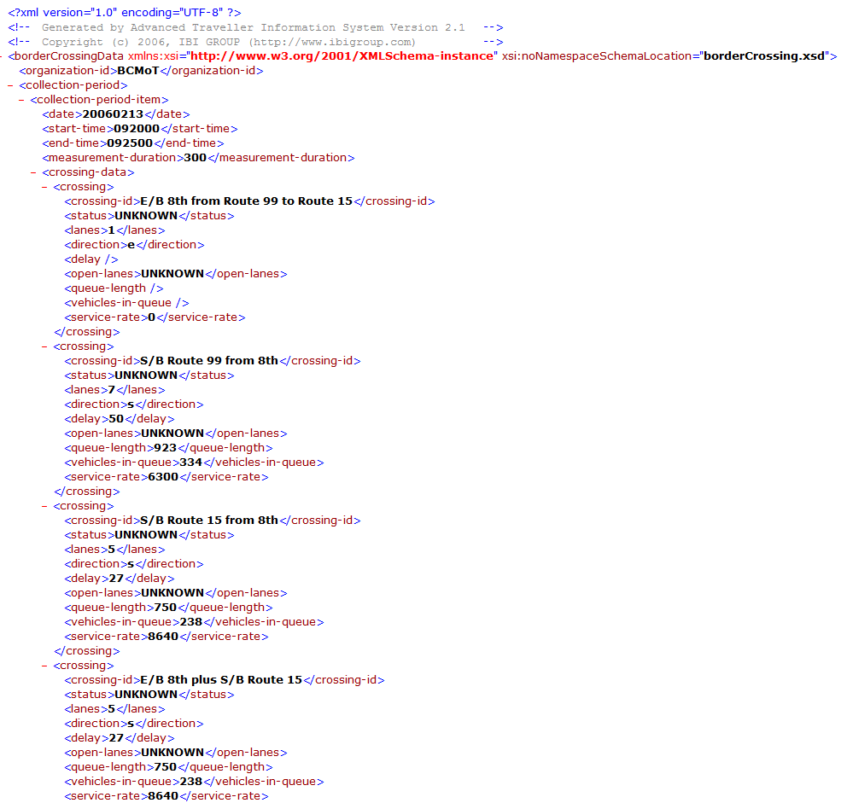
Problems with the original schema
Timestamp issues.
Repetitive information.
Designed for time periods, not instances.
Not for all detector types.

Slide 10
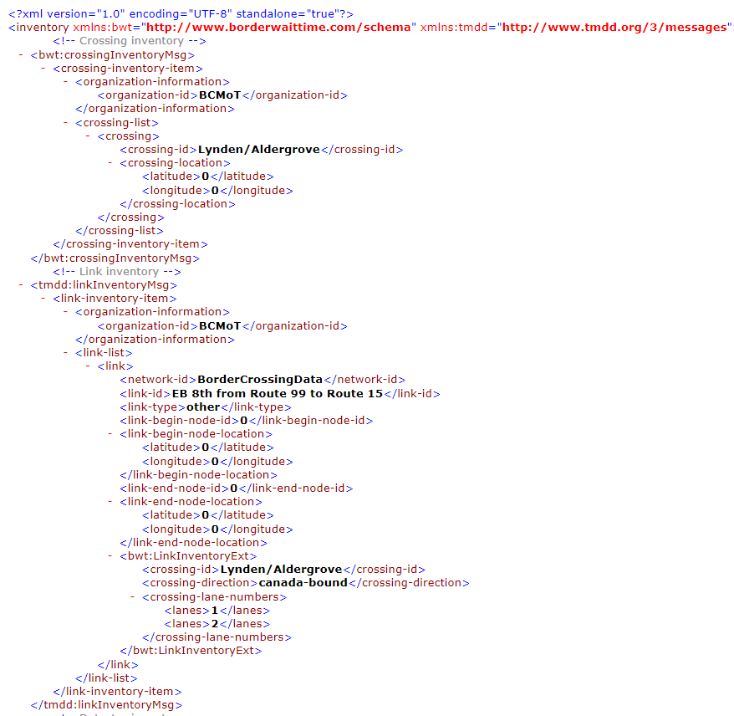
Inventory
Organized under system components more intuitive
Describes details of system in one location
TMDD with custom bwt elements

Slide 11
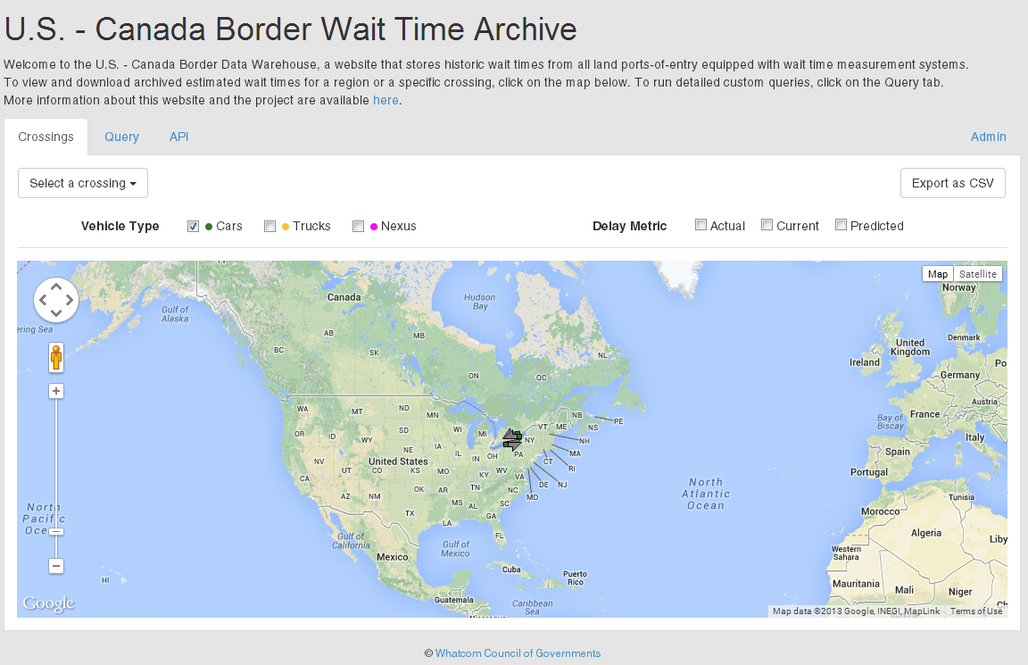
National portal interface
Starts at the macro level.
B.C. MINISTRY OF
WA STATE DEPT. OF TRANSPORTATION
Updates every five minutes
Wait time by crossing
Wait time by mode
Volume
Queue length (mi)

Slide 12
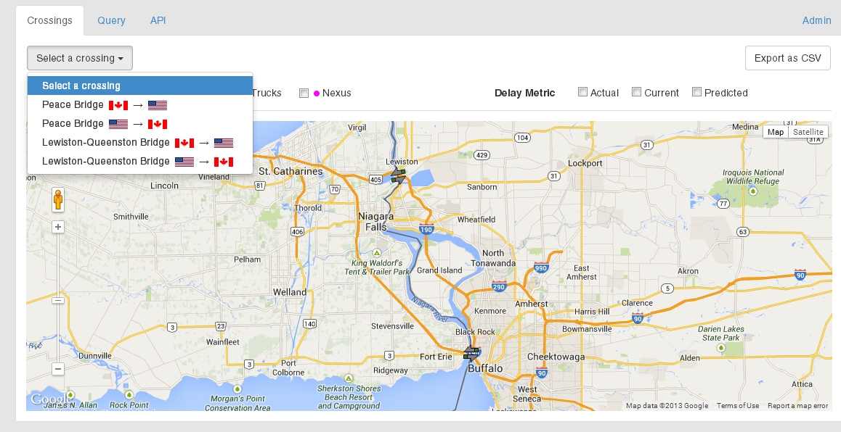
Crossings are selected by region.

Slide 13
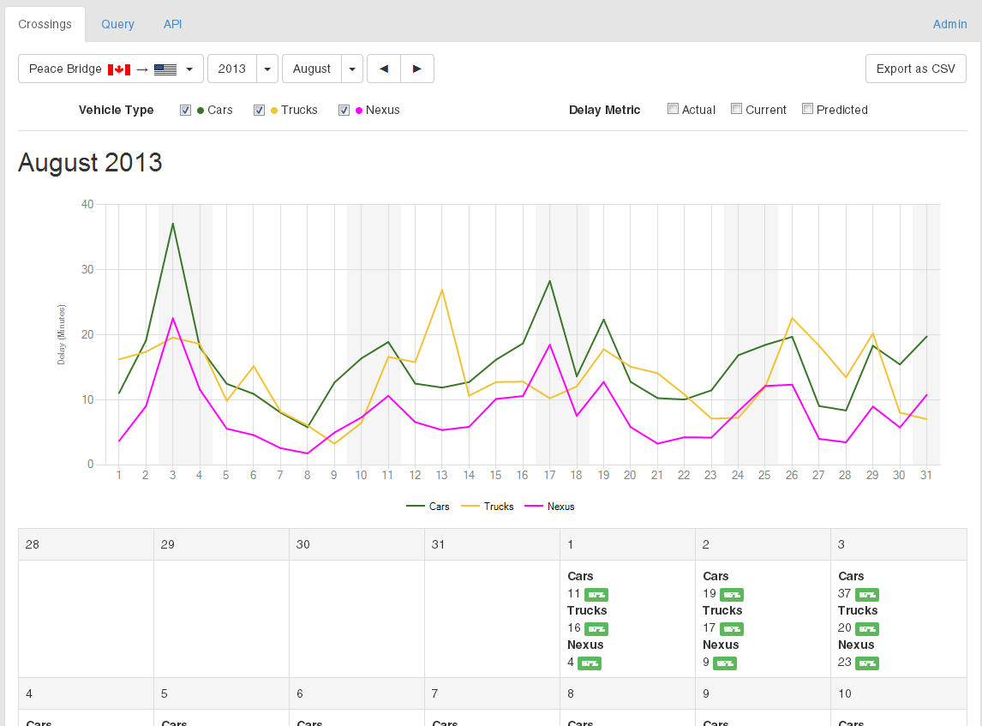
Monthly detail view.
Vehicle types available.
Graph, chart, or download

Slide 14
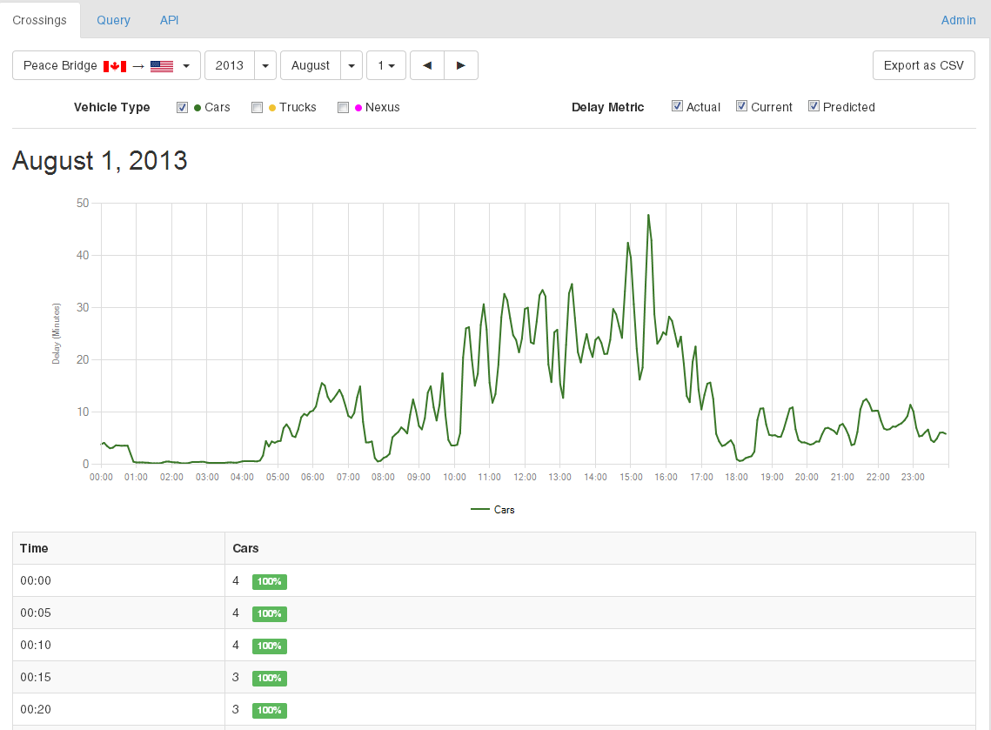
Monthly detail view.
Download by day too.
Eventually by multiple metrics.

Slide 15
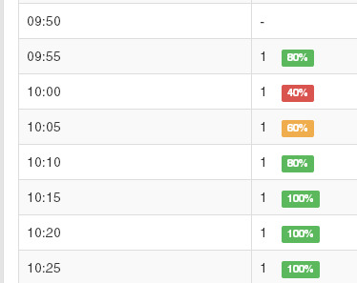
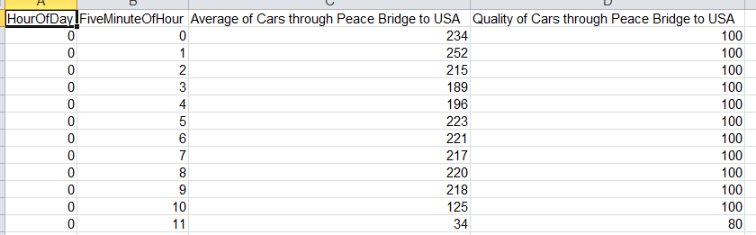
Quality rankings
Determined by how many datasets are complete.
B.C. MINISTRY OF
Included in downloads..

Slide 16
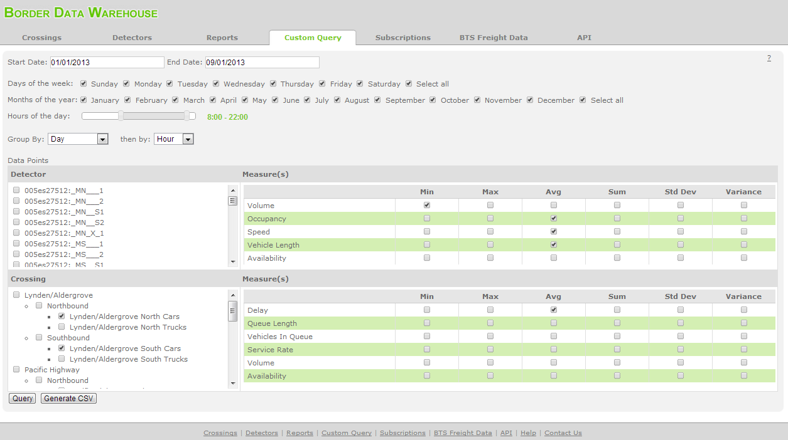
Custom query searches are coming.

Slide 17
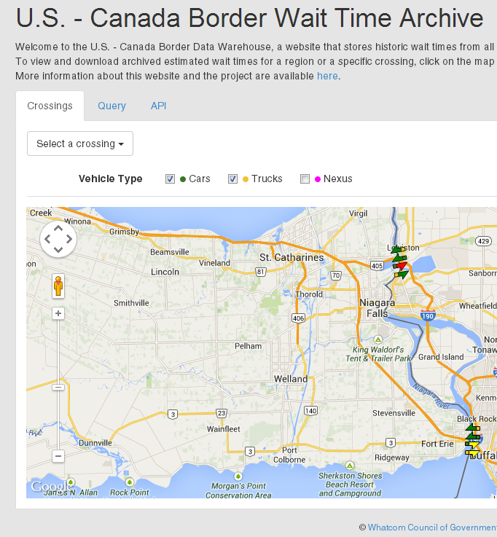
API flexibility built in.
Documenta-tion for linking directly to database.

Slide 18
Feedback?
<?xml version="1.0" encoding="UTF-8"?>
<borderCrossingData xmlns:xsi="http://www.w3.org/2001/XMLSchema-instance" xsi:noNamespaceSchemaLocation="borderCrossing.xsd">
<organization-id>BCMoT</organization-id>
<inventory>
<detectors>
<detector>
<id></id >
<name></name>
<device-id></device-id>
<device-type> </device-type>
<lanes>
<lane-number></lane-number>
<lane-number></lane-number>
<lane-number></lane-number>
</lanes>
<road-name></road-name>
<direction></direction>
<booth-id>4</booth-id>
</detector>
</detectors>
<booths>
<booth>
<id></id>
<type></type>
<direction></direction>
Please contact me.
Melissa Fanucci
Senior Planner
Whatcom COG
360-676-6974
melissa@wcog.org

